Slide 1
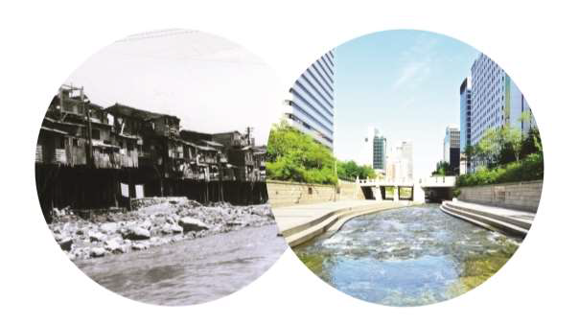
How did the East Asian ‘Tigers’ deliver sanitation within a generation? Lessons for the SDGs
Barbara Frost
March 2016
Sanitation and Water for All
Notes:
SDGs require us to think differently
WaterAid wanted to find out what could be learned from East Asia. What were the public policy drivers of countries that helped them to achieve Universal Access to Sanitation
Not a question of seeking blueprints of success. But we started with the questions of “what can be learned from East Asia and is any of this useful for other states seeking to achieve the transformation required?”
[These two pictures show the same stream ( Cheong-Gae ) in Seoul in the 1960s and now. You can see the transformation from slum dwellings with unimproved sanitation. A big part of the story that we have found is that the changes in the built environment that you can see here are hard to separate from the sanitation story.]

Slide 2
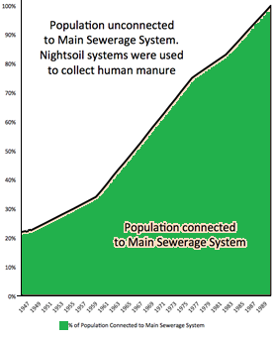
Transformational Change
S. Korea
Singapore
1970 --------------------- 1990
1947 --------------------- 1983
Notes:
2 countries looked at. JMP figs not available then, but proxy indicators used. (S Korea endo-parasitic infections, Singapore connected to mains sewerage last point of sanitation ladder).
In the case of South Korea and Singapore, we see a similar quantum leap in progress that we need to see now in some Least Developed Countries.
Important to recognise very different ‘starting conditions’. But what we do know is that wealth or economic development was not a necessary condition…
Explain proxy indicators.
[In 1962, Korea Housing Corporation commissioned Seoul National University’s
Engineering College to survey the national housing status.
The survey included sanitation data such as the presence/absence of toilets and their locations. From its
survey of toilets in 1753 households that have separate kitchens and living quarters, only 1% had sitting flush/toilets.
18% had squatting flush toilets. 76% were using pit latrines. 2% were using other temporary structures such as jars.]

Slide 3
GDP and Sanitation
GDP/capita
South Korea $155
Zambia $227
Senegal $249
1990 South Korea had 90% plus coverage

Slide 4
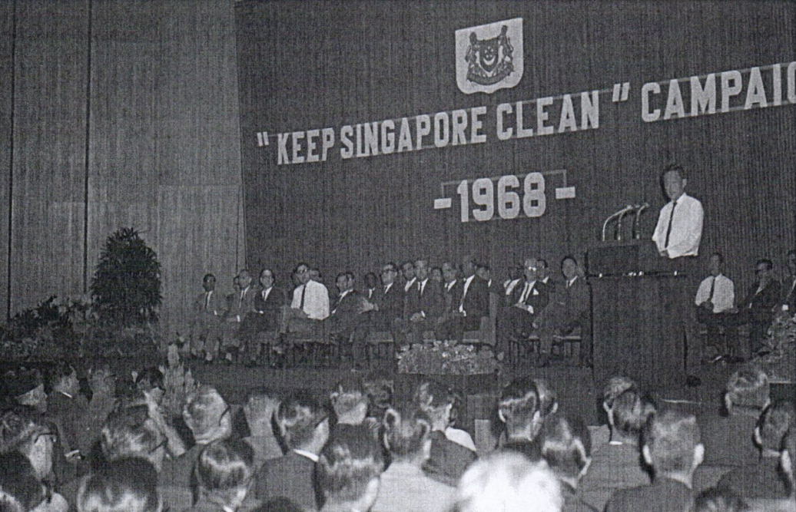
Leadership is critical
High-level leadership:
Relentless Championing:
Hygiene, Public Health and Cleanliness as drivers of development and ‘modernity’
Driving Progress:
Legislative and institutional reforms, behaviour change, ongoing adaptation, monitoring and reform
“Let’s Try To
Live Well”
- President Park, South Korea
Notes:
Leadership at all levels is critical. But 2 important aspects:
High level political leadership that tied sanitation and hygiene behaviours to national development goals and notions of modernity. It was about associating the achievement of universal access to Sanitation as part of a national ‘transformation’.
But an essential element of leadership at all levels was the relentless progress-chasing. Leaderships were engaged in the challenges of implementation. For instance, Pres. Park Cheung Hee in South Korea issued a Presidential Decree on Sanitation once every 2 years to try and free up bottlenecks and make ‘course corrections’ for more effective implementation.

Slide 5
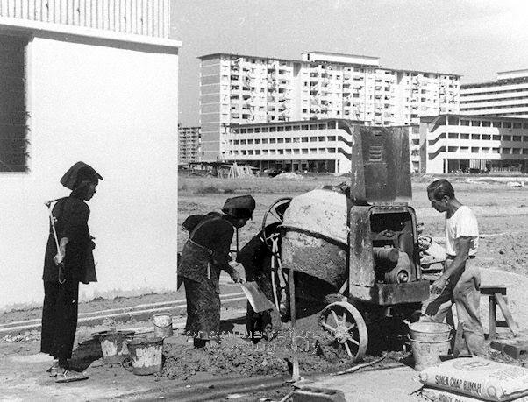
Integrated Approach
Rapid sanitation improvements and wider transformation need a co-ordinated approach
Urban renewal
Housing
Education
Health
Notes:
Universal Access to Sanitation was part and parcel of a broader national and local level ‘transformation’.
It required multi-sector planning, but vertical sector delivery – a. It was part of urban renewal, of education and it was led by environmental health ministries.
There was no such thing as a separate sanitation ministry but it was a “whole-of-govt-approach” with changed approaches to hygienic practices at its central aim.

Slide 6
“
“Your function, first and foremost, is a function of a
‘breaker of bottlenecks ...”
“once a week, we have what I call ‘morning prayers’ where all departmental officers get together and instead of writing tedious minutes on files to each other, they settle their departmental differences together, in a coordinated way, in front of the maps in their operations rooms.”
Deputy Prime Minister, Malaysia 1965 and 1966
Notes:
Deputy PM of Malaysia:
“[Development teams] must also, at least once a week, have what I call ‘morning prayers’ where all departmental officers get together and instead of writing tedious minutes on files to each other, they settle their departmental differences together, in a coordinated way, in front of the maps in their operations rooms.”

Slide 7
In summary…
Political leadership and engagement
Vision - nation building, public health, cleanliness, modernity, prosperity
Co-ordinated multi-sectoral approach
Constant cyclical monitoring, adaptation and course correction
Capacity building alongside improvements
Notes:
In summary
Leadership matters. But it’s leadership that is not content with signing a declaration or delivering a speech. It was leadership at all levels that progress-chased delivery and was quick to respond to problems.
Hygiene, behaviour change and a resolve to tackle the public health dimensions of the sanitation crisis was at the forefront of implementation
Planning was multi-sector and with a strong leading role by the Health sector.
The programmes were ‘big bang’ in the sense that they built capacity alongside their implementation.
Above all, what we see is a continuous cycle of monitoring and adaptation.

Slide 8
SWA Behaviours Leadership Strengthening Country Systems Mutual Accountability Financing

Slide 9
Thanks

